Slide 1
Level of Detail Expressions (LOD)
-Ashu Mehta
Database systems

Slide 2
LOD Expressions
Level of Detail expressions (also known as LOD expressions) allow you to compute values at the data source level and the visualization level
LOD expressions let you control the granularity you want to compute.
They can be performed at a more granular level (INCLUDE), a less granular level (EXCLUDE), or an entirely independent level (FIXED).
LOD Types
Fixed
Include
Exclude

Slide 3
Fixed LOD
Independent of dimensions in the view.
Always show same values in the view irrespective of the dimensions.

Slide 4
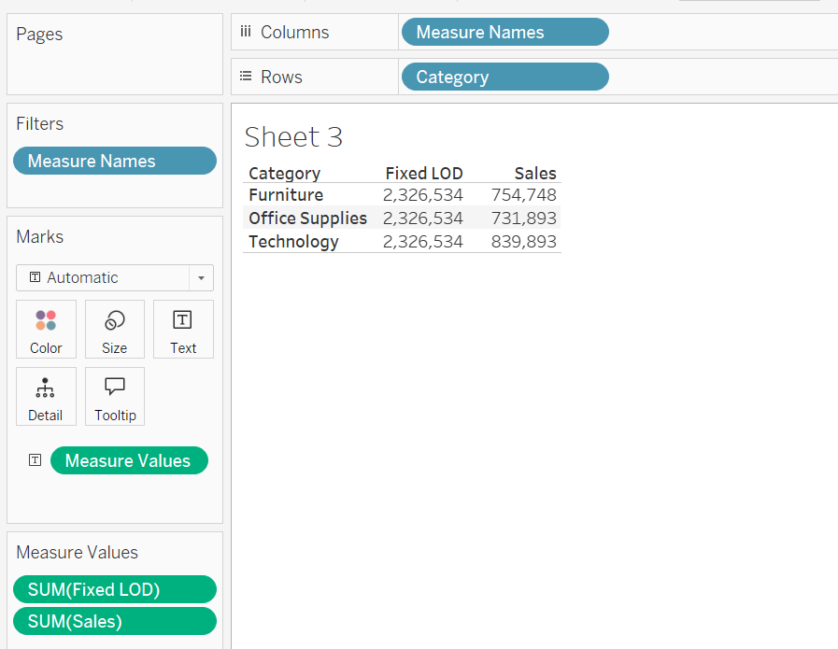
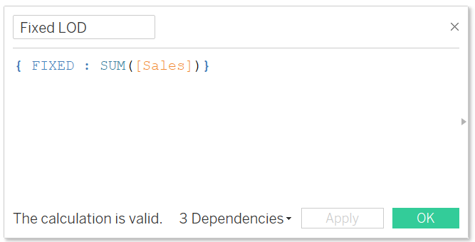
Example1

Slide 5
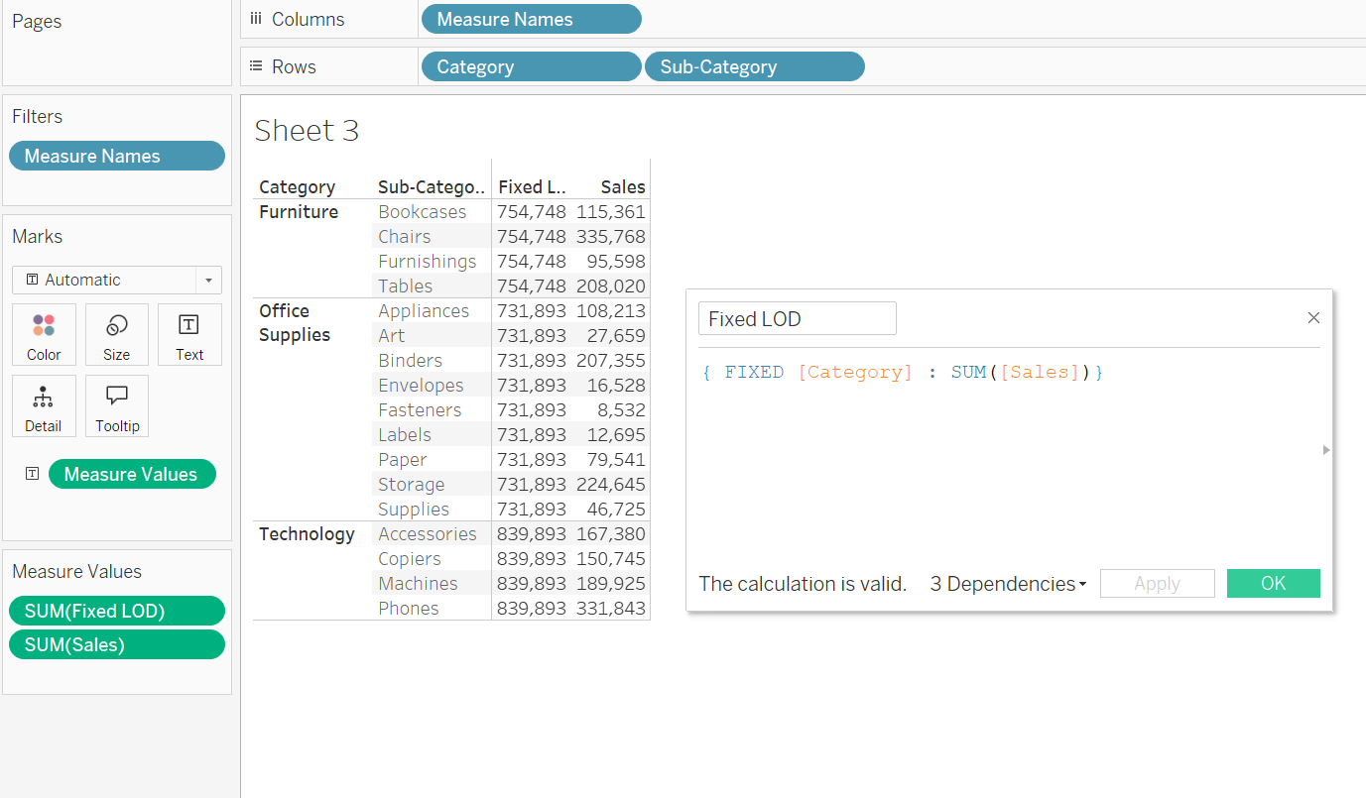
Example 2- Fixed Category

Slide 6
Exclude
Removes what is in the expression
Show lesser details in the view

Slide 7
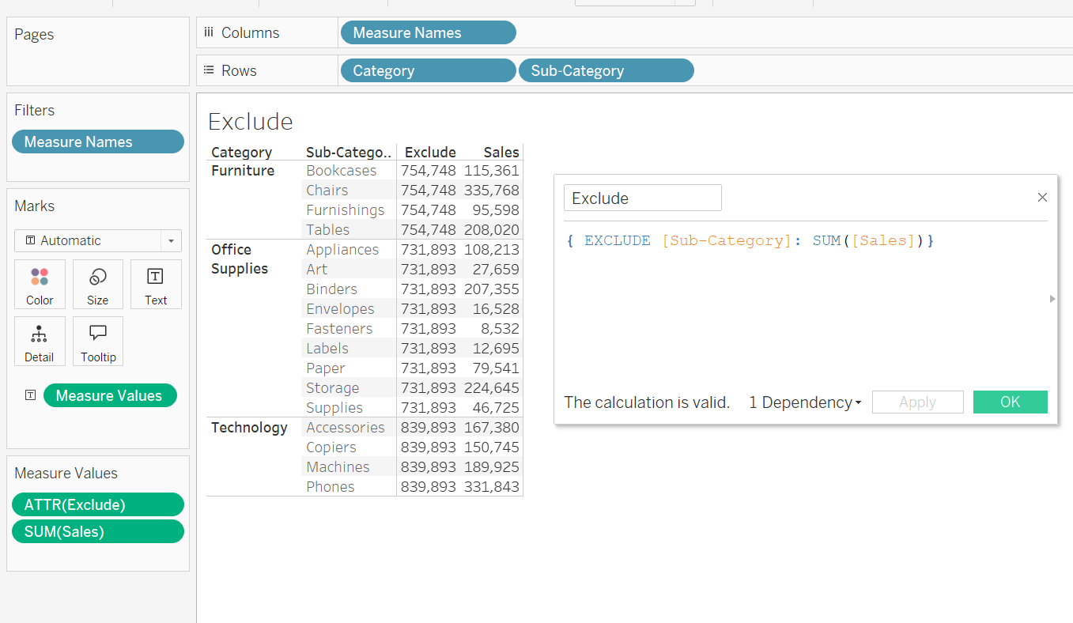
Example 1- Exclude Sub-category

Slide 8
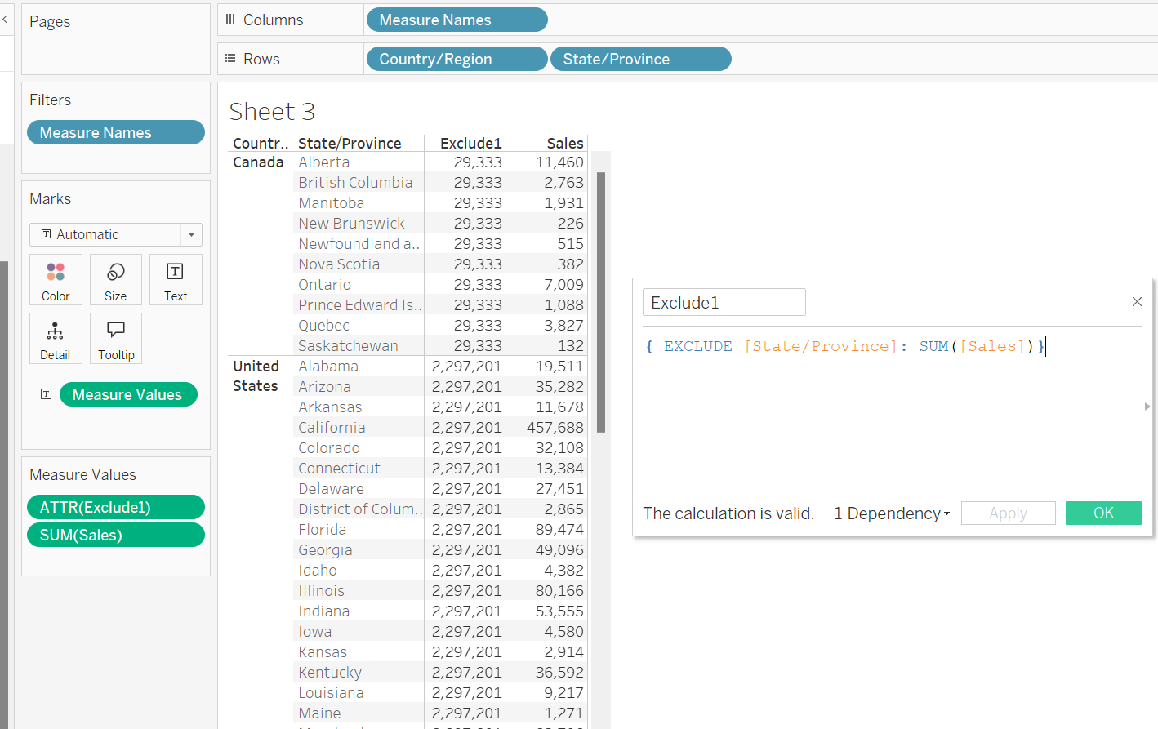
Example 2- Exclude State

Slide 9
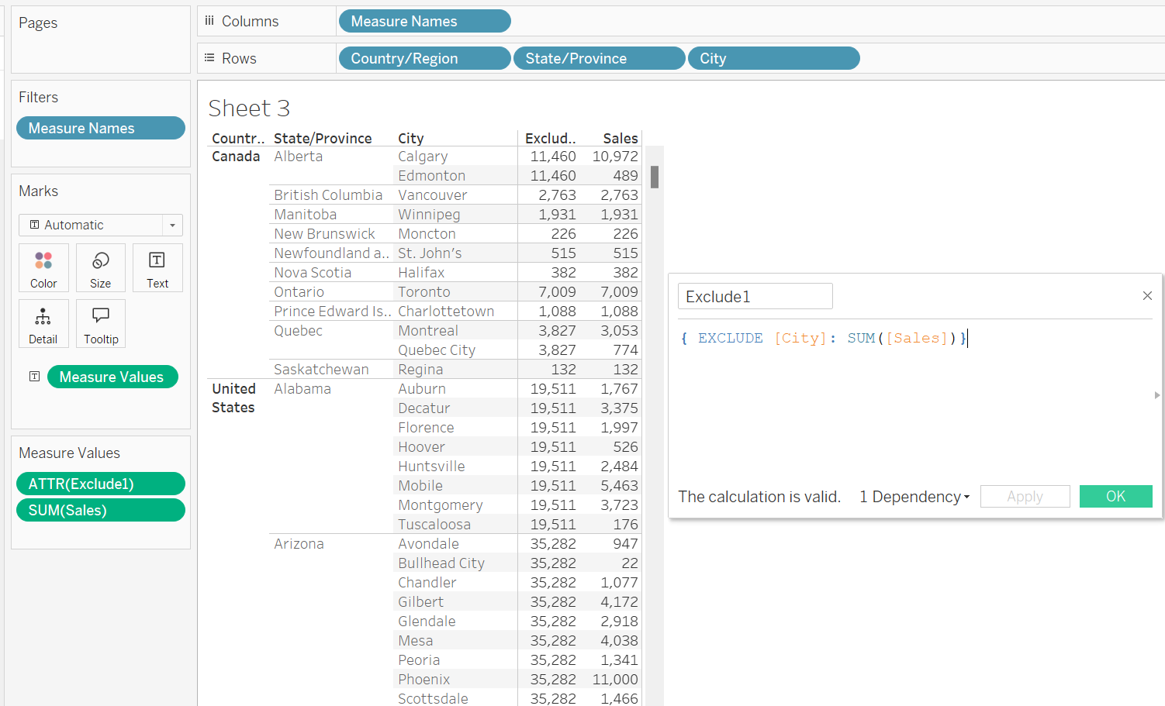
Example 3- Exclude City

Slide 10
Include
Adds what is in the expression
Adds more details to the view

Slide 11
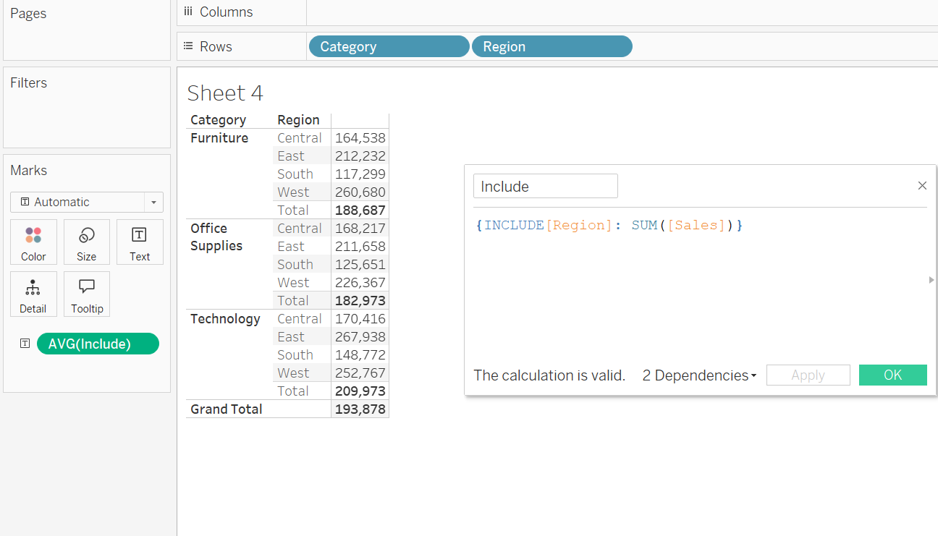
Example- Include region

Slide 12
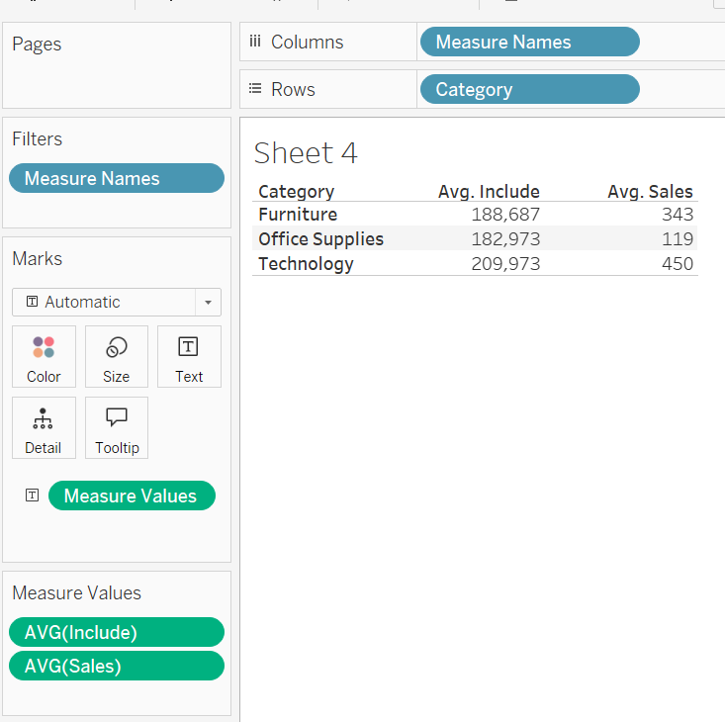
Showing same Avg sales for category even if region is not in the view

